Slide 1
Business Intelligence
Lecture 2

Slide 2
Lecture Agenda
Data Driven Project (DDP)
Business Approach to DDP
Key Performance Indicators (KPI)
Business Modeling

Slide 3
Data Driven Project

Slide 4

Data Driven Project
When a company employs a “data-driven” approach, it means it makes strategic decisions based on data analysis and interpretation.
A data-driven approach enables companies to examine and organize their data with the goal of better serving their customers and consumers.

Slide 5
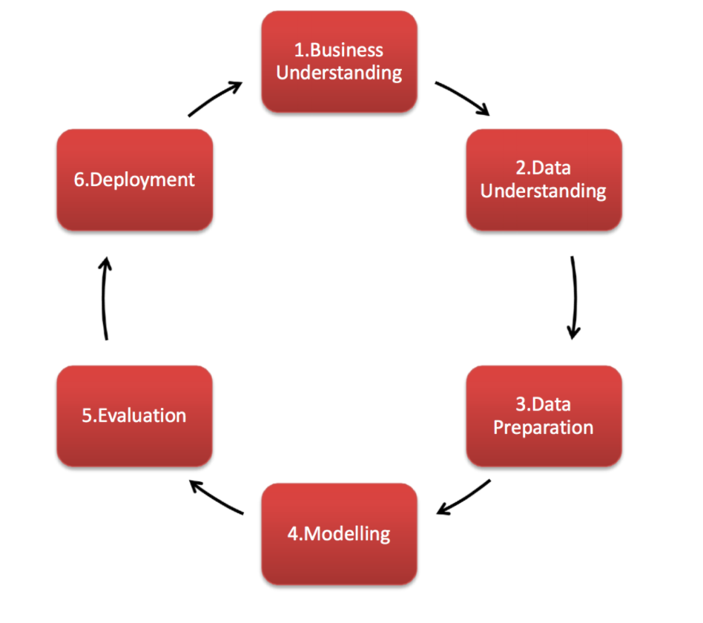
CRISP-DM
Cross-Industry Standard Process for Data Mining, known as CRISP-DM, is a model that describes common approaches used by data mining experts. It is the most widely-used analytics model. CRISP breaks the process of data mining into six major phases:

Slide 6

1. Business Understanding
Understand what you want to accomplish from a business perspective.
Your organization may have constraints that must be properly balanced.
Cover important factors that could influence the outcome of the project.
Bottom line: what is your business goal in this project?

Slide 7
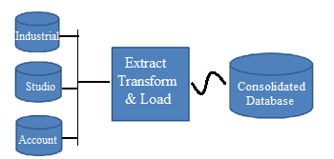
2. Data Understanding
Acquire the data listed in the project resources.
This initial collection includes data loading, if this is necessary for data understanding.
If you acquire multiple data sources, then you need to consider how and when you’re going to integrate these.

Slide 8
3. Data Preparation
Select This is the stage of the project where you decide on the data that you’re going to use for analysis.
The criteria you might use to make this decision include the relevance of the data to your data mining goals
Data selection covers selection of attributes (columns) as well as selection of records (rows) in a table.

Slide 9
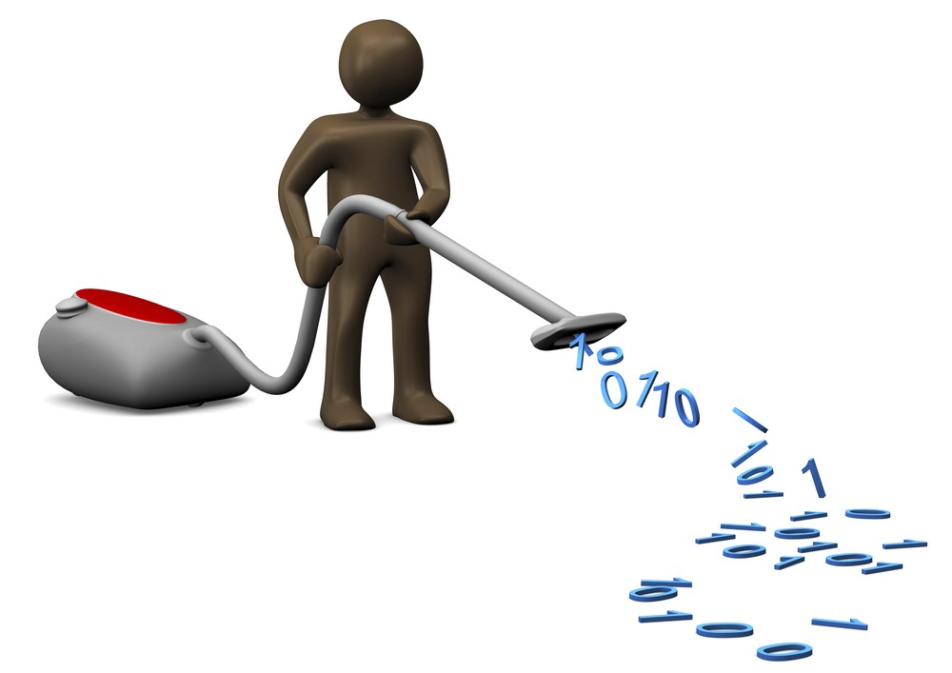
3. Data Preparation
Clean This task involves raise the data quality to the level required by the analysis techniques that you’ve selected.
This may involve selecting clean subsets of the data, the insertion of suitable defaults, or more ambitious techniques such as the estimation of missing data by modelling.

Slide 10
3. Data Preparation
Construct This task includes constructive data preparation operations such as the production of derived attributes or entire new records, or transformed values for existing attributes.
Integrate These are methods whereby information is combined from multiple databases, tables or records to create new records or values.

Slide 11
4. Modeling
Technique As the first step in modelling, you’ll select the actual modelling technique that you’ll be using. Although you may have already selected a tool during the business understanding phase, at this stage you’ll be selecting the specific modelling technique e.g. decision-tree, clustering, neural networks, etc.
If multiple techniques are applied, perform this task separately for each technique.

Slide 12
4. Modeling
Build run the modelling tool on the prepared dataset to create one or more models.
Assess your data mining success criteria and your desired test design.
Judge the success of the application of modelling and discovery techniques technically
Contact business analysts and domain experts to discuss the data mining results
This task only considers models, whereas the evaluation phase also takes all other results that were produced in the project.

Slide 13
5. Evaluation
Determine if there is some business reason why this model is deficient.
The evaluation phase involves assessing any other data mining results you’ve generated.
Data mining results involve models that are necessarily related to the original business objectives
might also include additional challenges, information, or hints for future directions.

Slide 14
6. Deployment
In the deployment stage you’ll take your evaluation results and determine a strategy for their deployment.
This is where predictive analytics really helps to improve the operational side of your business.
Final Report - depending on the deployment plan, this report may be only a summary of the project and its experiences, or it may be a final and comprehensive presentation of the data mining result(s).

Slide 15
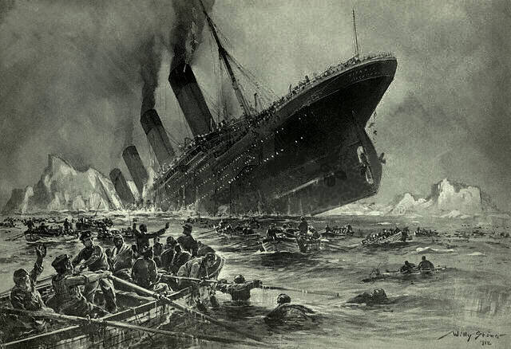
Example
The sinking of the Titanic is one of the most infamous shipwrecks in history. On April 15, 1912, during her maiden voyage, the Titanic sank after colliding with an iceberg, killing 1502 out of 2224 passengers and crew (32% survival rate).

Slide 16
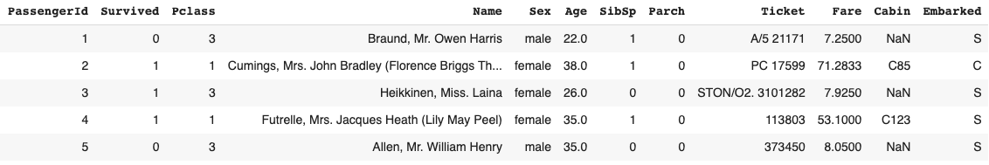
Example
One of the reasons that the shipwreck led to such loss of life was that there were not enough lifeboats for the passengers and crew. Although there was some element of luck involved in surviving the sinking, some groups of people were more likely to survive than others, such as women, children, and the upper-class.
Business understanding - what characterizes the survivors?

Slide 17
Example
The problem is a binary class classification problem, so we need to choose the right model for this problem.
For example, linear regression is not a good choice.

Slide 18
Key Performance Indicator (KPI)

Slide 19
What is A KPI
A KPI (Key Performance Indicator) is a metric that is tied to a target.
A KPI represents how far a metric is above or below a pre-determined target.
Choosing the right KPI is crucial to make effective, data-driven decisions.
Right KPI will help to concentrate the efforts of employees towards a meaningful goal
Wrong KPI could waste significant resources chasing after vanity metrics
A great KPI is SMART (Specific, Measurable, Achievable, Relevant, Time phased)

Slide 20
The Five Conditions of good KPI’s - SMART
Specific
It has to be clear what the KPI exactly measures
Measurable
The KPI has to be measurable to define a standard, budget or norm, to make it possible to measure the actual value and to make the actual value comparable to the budgeted value
Achievable
“Nothing is more discouraging than striving for a goal that you will never obtain”

Slide 21
The Five Conditions of good KPI’s - SMART
Relevant
- Must give more insight in the performance of the organization
- If a KPI is not measuring a part of the strategy, acting on it doesn’t affect the organizations’ performance.
- An irrelevant KPI is useless.
Time phased
It is important to express the value of the KPI in time

Slide 22

How To Achieve Success?
Identify areas of activity that require greater attention
Performance indicators that are grounded (SMART)
Agile development
Business understanding

Slide 23
KPI vs Metrics
KPIs are the key targets you should track to make the most impact on your strategic business outcomes. KPIs support your strategy and help your teams focus on what’s important.
Metrics measure the success of everyday business activities that support your KPIs. While they impact your outcomes, they’re not the most critical measures.

Slide 24
Why Are KPIs Important?
Keep your teams aligned
Whether measuring project success or employee performance, KPIs keep teams moving in the same direction.
Provide a health check
Key performance indicators give you a realistic look at the health of your organization, from risk factors to financial indicators.

Slide 25
Why Are KPIs Important?
Make adjustments
KPIs help you clearly see your successes and failures so you can do more of what’s working, and less of what’s not.
Hold your teams accountable
Make sure everyone provides value with key performance indicators that help employees track their progress and help managers move things along.

Slide 26
Examples of KPIs
Sales: number of new contracts signed per period
Financial: growth in revenue
Customers: products usage, customers satisfaction
Operational: TTM – Time To Market
Marketing: monthly customers' traffic

Slide 27
Data Mining for Decision Making

Slide 28
What Is Data Mining?
Knowledge discovery (mining) in databases (KDD)
knowledge extraction
data/pattern analysis
data archeology
information harvesting

Slide 29
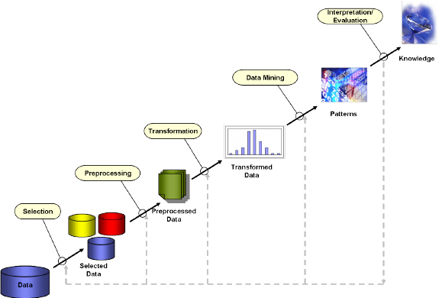
Knowledge Discovery (KDD) Process

Slide 30
Data Mining and Business Intelligence
Increasing potential
to support
business decisions
End User
Decision Making
Data Presentation
Business
Analyst
Visualization Techniques
Data Mining
Data
Analyst
Information Discovery
Data Exploration
Statistical Summary, Querying, and Reporting
Data Preprocessing/Integration, Data Warehouses
Data Sources
DBA
Paper, Files, Web documents, Scientific experiments, Database Systems

Slide 31
Applications
Market analysis and management
Target marketing, customer relationship management (CRM)
Risk analysis and management
Forecasting, customer retention, improved underwriting, competitive analysis
Fraud detection
Detection of unusual patterns (outliers)

Slide 32
Example - Market Analysis and Management
Where does the data come from?
Credit card transactions, loyalty cards, discount coupons, customer complaint calls, surveys …
Target marketing
Find clusters of “model” customers who share the same characteristics. For example, most customers with income level 60k – 80k with food expenses $600 - $800 a month live in that area.
Determine customer purchasing patterns over time. For example, customers who are between 20 and 29 years old, with income of 20k – 29k usually buy this type of CD player
Cross-market analysis
customers who buy computer A usually buy software B

Slide 33
Example - Market Analysis and Management
Customer requirement analysis
Identify the best products for different customer, Predict what factors will attract new customers
Summary information
Multidimensional summary reports
Summarize all transactions of the first quarter from three different branches
Summarize all transactions of last year from a particular branch
Statistical summary information
What is the average age for customers who buy product A?
Fraud detection: find outliers of unusual transactions
Financial planning: summarize and compare the resources and spending

Slide 34
Types of Data
Database-oriented data sets and applications
Relational database, data warehouse, transactional database
Advanced data sets and advanced applications
Object-Relational Databases
Time-Series databases
Spatial Databases
Text databases and Multimedia databases
Data Streams
The World-Wide Web

Slide 35
Data Mining Models and Tasks
Data Mining
Predictive
Descriptive
Classification
Regression
TSA
Clustering
Association Rules

Slide 36
SQL – DML and DDL

Slide 37
SQL - Structured Query Language
Query Language
Table Oriented
Fast and Easy access to our data
CRUD - Create, Read, Update, Delete

Slide 38
SQL
DML - Data Manipulation Language
Select
Insert
Update
Delete
DDL - Data Definition Language
Create
Drop
Alter

Slide 39
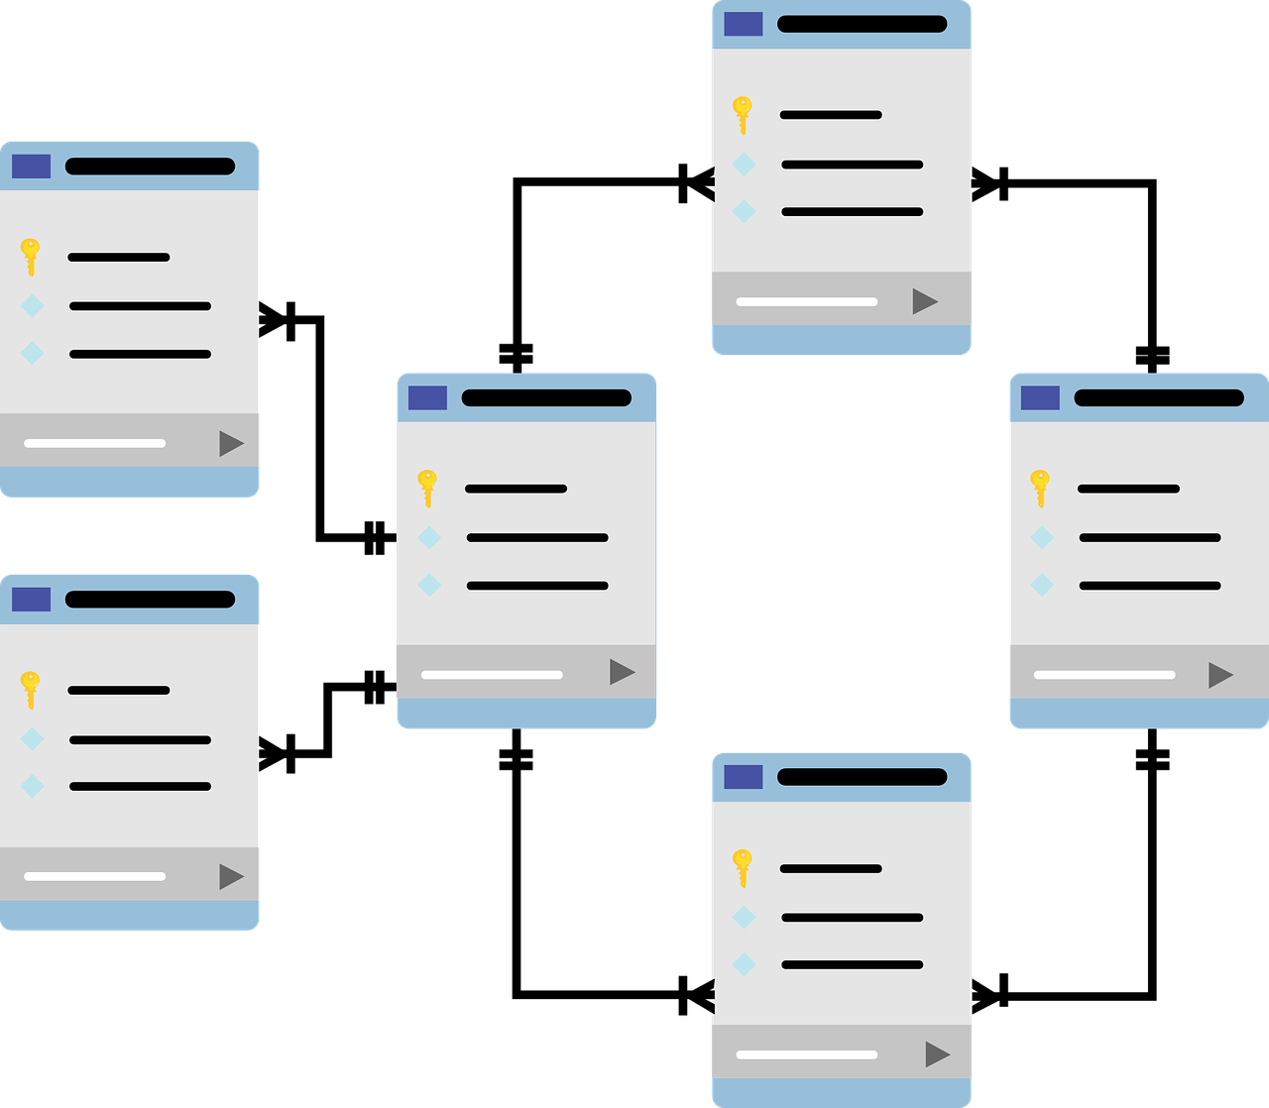
Overview
What happens when we want to handle a few tables which relative
one to each other ?

Slide 40
Courses
StudentID | CourseNumber | CourseName | Grade
111 | 289 | DB | 96
111 | 281 | Algo | 85
222 | 281 | Algo | 78
Foreign Key
Students
FirstName | LastName | StudentID
Avi | Cohen | 111
Dan | Israeli | 222
Ofer | Bar | 333
Primary Key

Slide 41

How to merge two tables ? - Option 1
SELECT FirstName, CourseName, Grade
FROM Students as S, Courses as C
Where (S.StudentID = C.StudentID) and (C.CourseName = ‘Algo’)

Slide 42

How to merge two tables ? - Option 2
SELECT FirstName, CourseName, Grade
FROM Students as S JOIN Courses as C
ON S.StudentID = C.StudentID
Where (C.CourseName = ‘Algo’)

Slide 43
ON VS. USING
When using JOIN statement we need to understand according to which column we want to join the tables.
We will use ON when the columns name is not equal.
We will use USING when the columns name is equal.

Slide 44

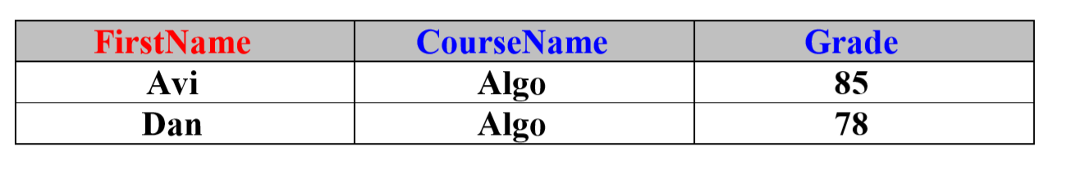
How to merge two tables ? - Option 3
SELECT FirstName, CourseName, Grade
FROM Students JOIN Courses
USING (StudentID)
Where (CourseName = ‘Algo’)

Slide 45
JOIN Types
INNER JOIN
OUTER JOIN
LEFT OUTER JOIN
RIGHT OUTER JOIN
FULL OUTER JOIN

Slide 46
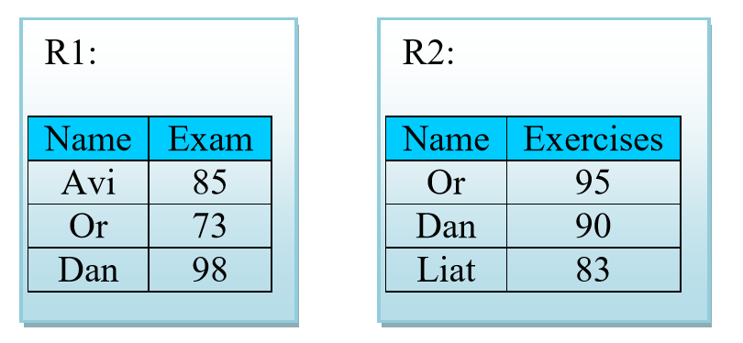
Let’s start with an example..
Given 2 Table called R1, R2:
Mutual column is “Name”

Slide 47
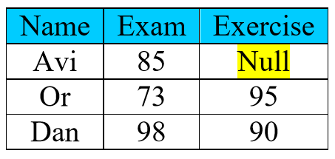
LEFT OUTER JOIN
What happens here? Why Avi has “null” value?
What happens if we use only “JOIN”?

Slide 48
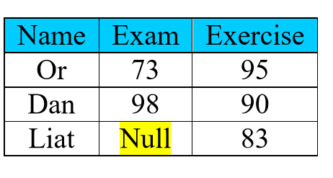
RIGHT OUTER JOIN
What happens here? Why Avi has “null” value?
What happens if we use only “JOIN”?

Slide 49
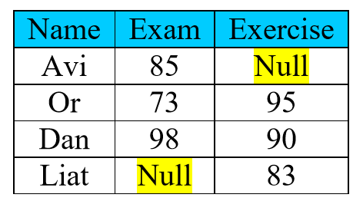
FULL OUTER JOIN
What happens here? Why Avi has “null” value?
What happens if we use only “JOIN”?

Slide 50
Handling NULL values
Sometimes part of our data is NULL, from many reasons:
Result of left/right/full outer join
Missing data while insert a new row
etc.
What if we want to know who is the problematic data?

Slide 51
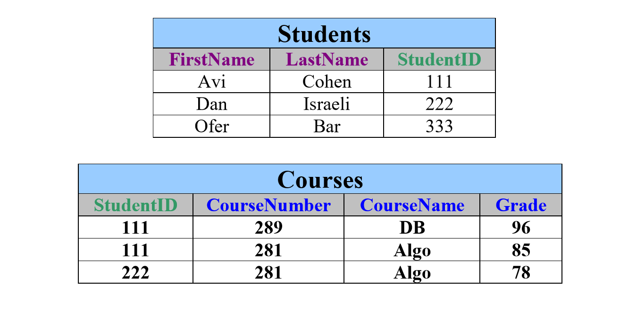
Example
Given 2 simple tables (Student and Courses, the favorite example):

Slide 52
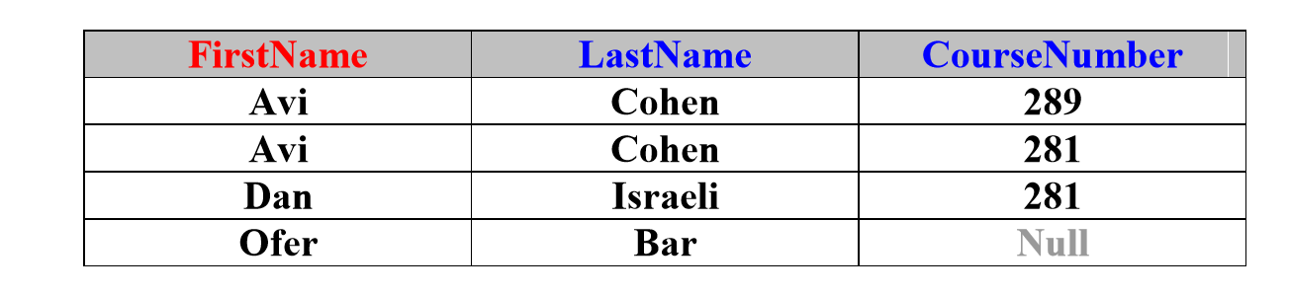
Example
SELECT FirstName, LastName, CourseNumber
FROM Student LEFT OUTER JOIN Courses
USING (StudentID)

Slide 53
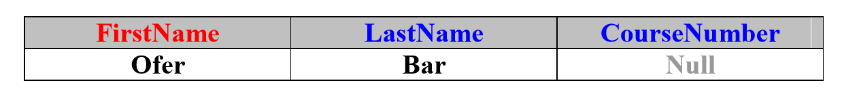
Example
We store the previous query on new table called NewCourses.
SELECT *
FROM NewCourses
WHERE CourseNumber is NULL

Slide 54
Important Notes
As we use “is NULL” , we can use “is NOT NULL”.
Wrong Usage: FirstName = ‘NULL’
NULL is not a String!

Slide 55
CREATE Tables
CREATE TABLE table_name
(
column_name1 data_type,
column_name2 data_type,
column_name3 data_type,
...
)

Slide 56
1 - Define your table schema + types
CREATE TABLE Students
(
Id int NOT NULL,
First_Name text,
Last_Name text,
Birth_Date date,
Hour_Salary float
)

Slide 57
2 - Insert Values (with the same order!)
INSERT INTO Students
VALUES(123456789, ‘Israel’, ‘Israeli’, ‘1980-03-20’, 120.40)

Slide 58
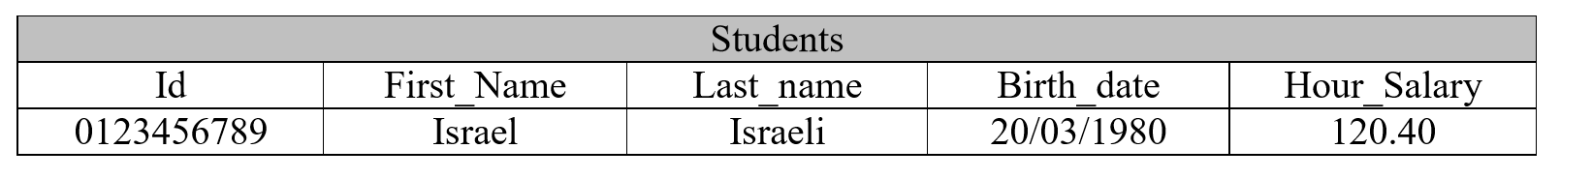
3 - Check your Insertion
SELECT *
FROM Students

Slide 59
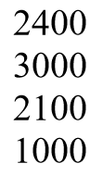
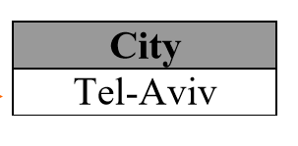
SubQuery with ALL
We want to find the city name where all amounts bigger (or equals) than all average amount of all cities.
SELECT City
FROM Students
GROUP BY City
HAVING AVG(Amount) >= ALL (SELECT AVG(Amount)
FROM Students
GROUP BY City)

Slide 60
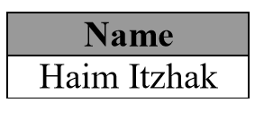
SubQuery with IN
We want to find all names which lives in one of the following cities: Eilat, Haifa, Jerusalem.
SELECT Name
FROM Students
WHERE City IN (‘Eilat’, ‘Haifa’, ‘Jerusalem’)

Slide 61
SubQuery with EXIST
What is the output of the following query?
SELECT SUM(Amount)
FROM Students
WHERE EXISTS (SELECT *
FROM AgudaMembers as AM
WHERE AM.Name = Students.Name)

Slide 62
